Slide 1

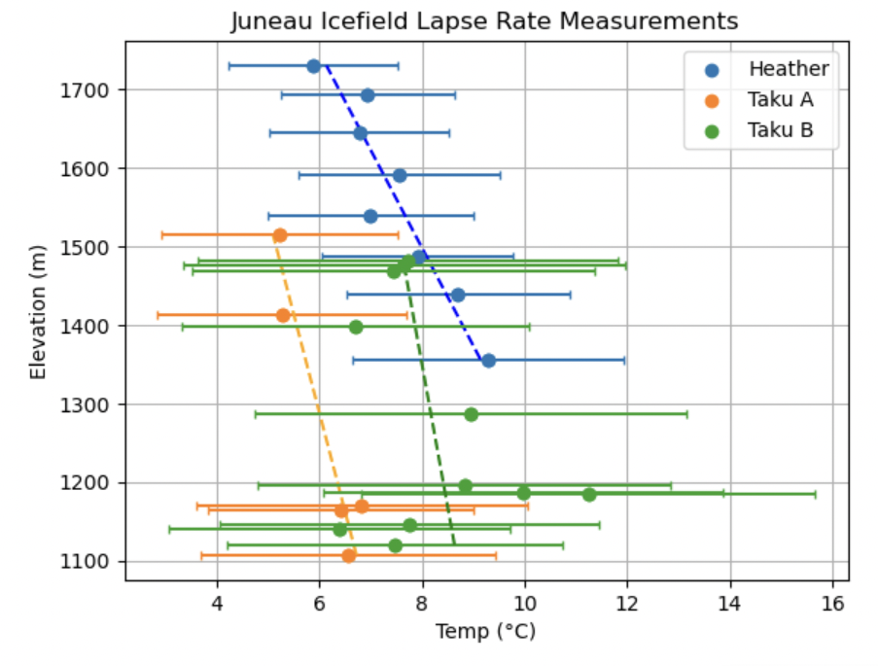
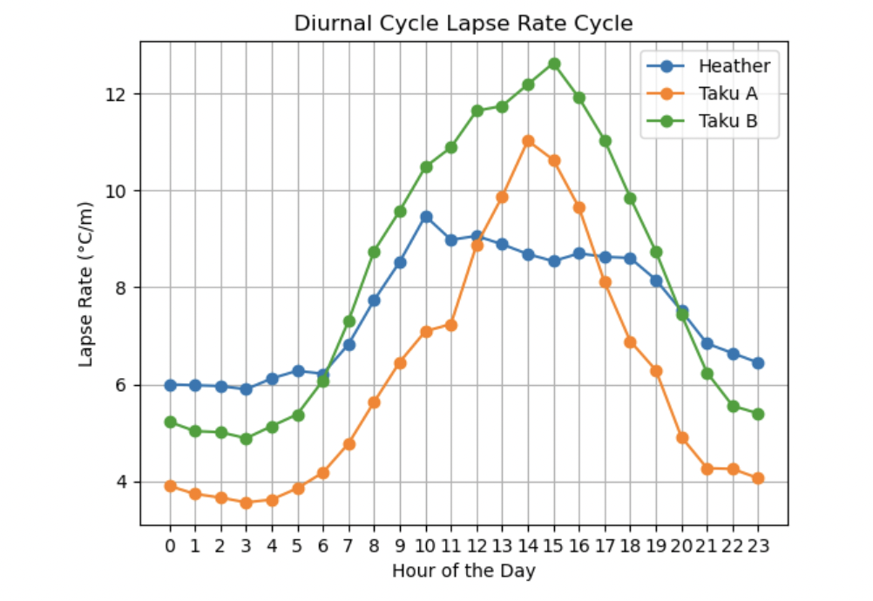
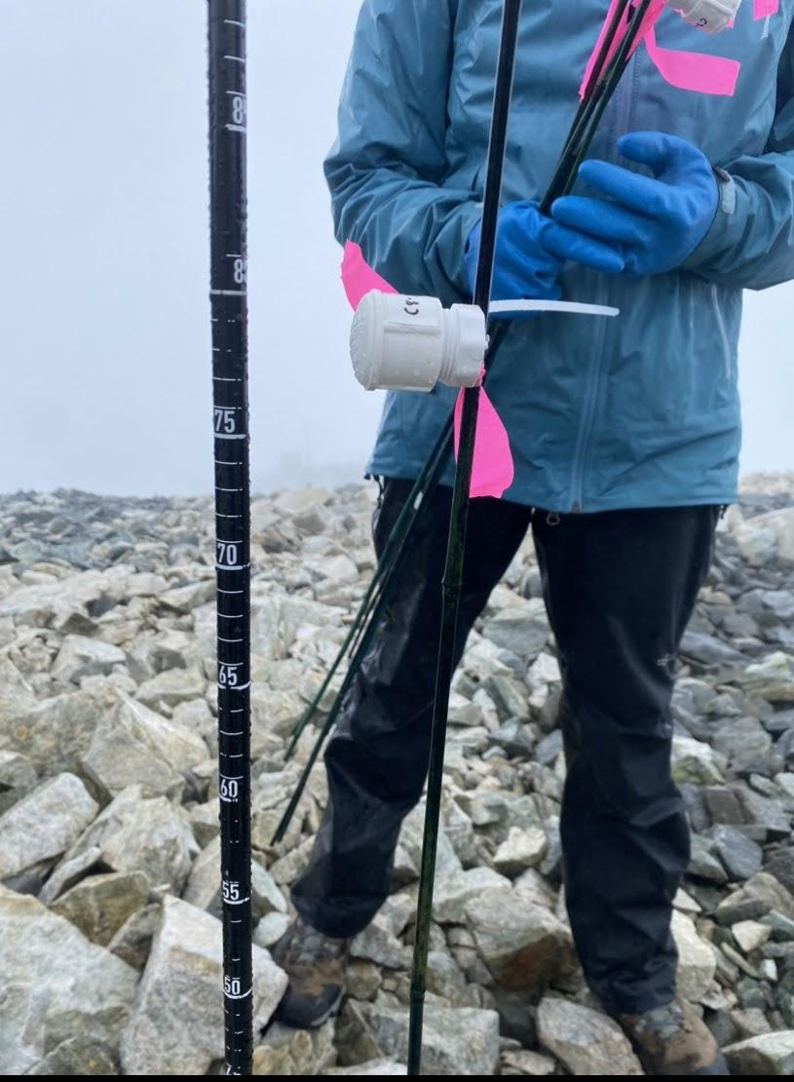
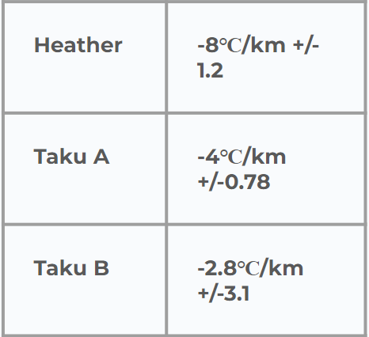
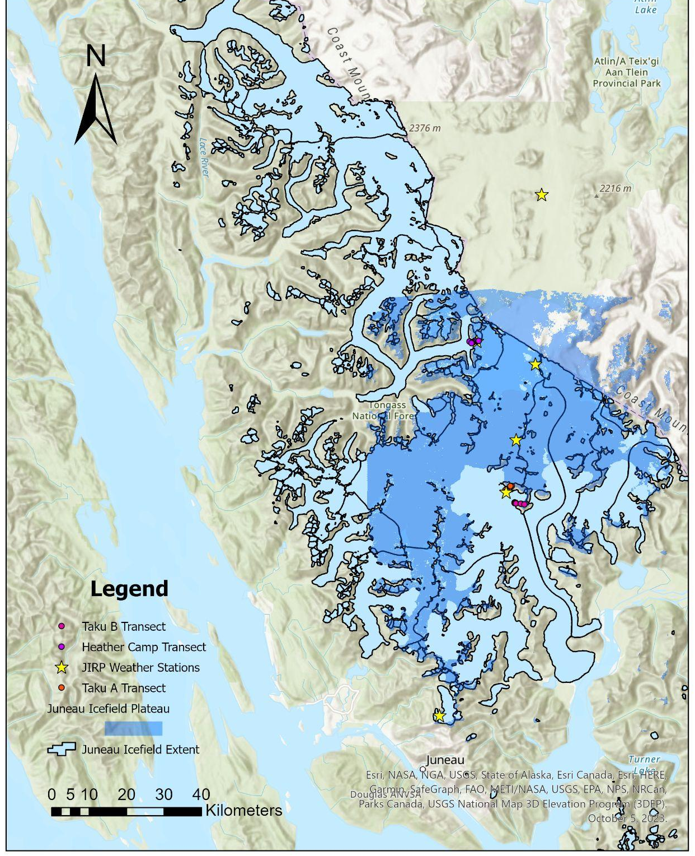
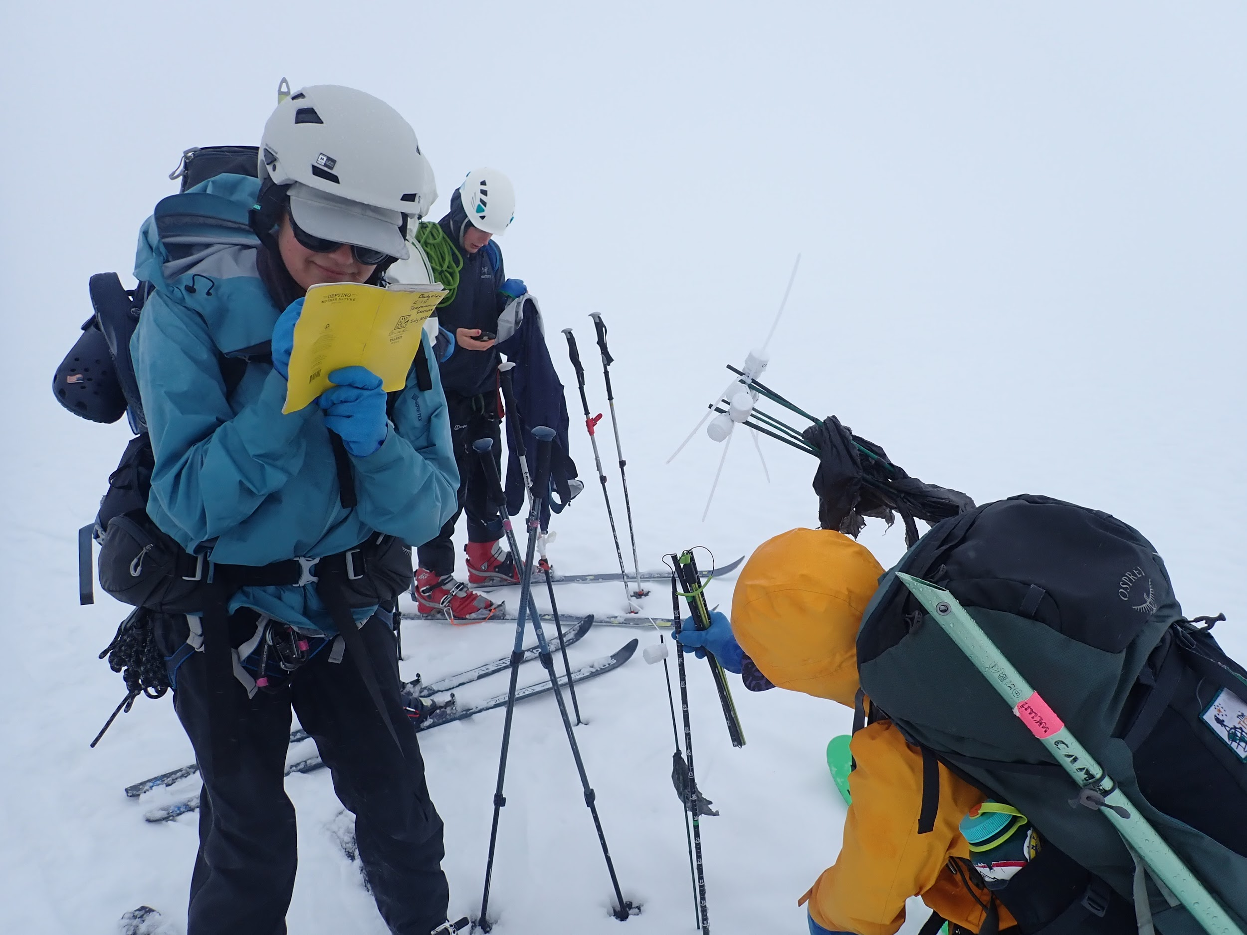
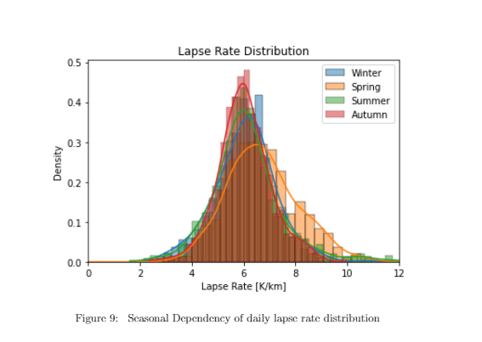
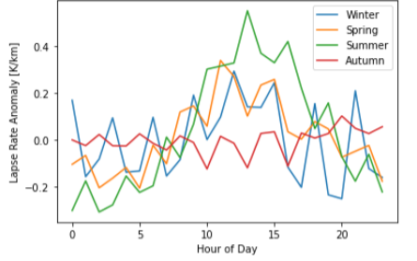
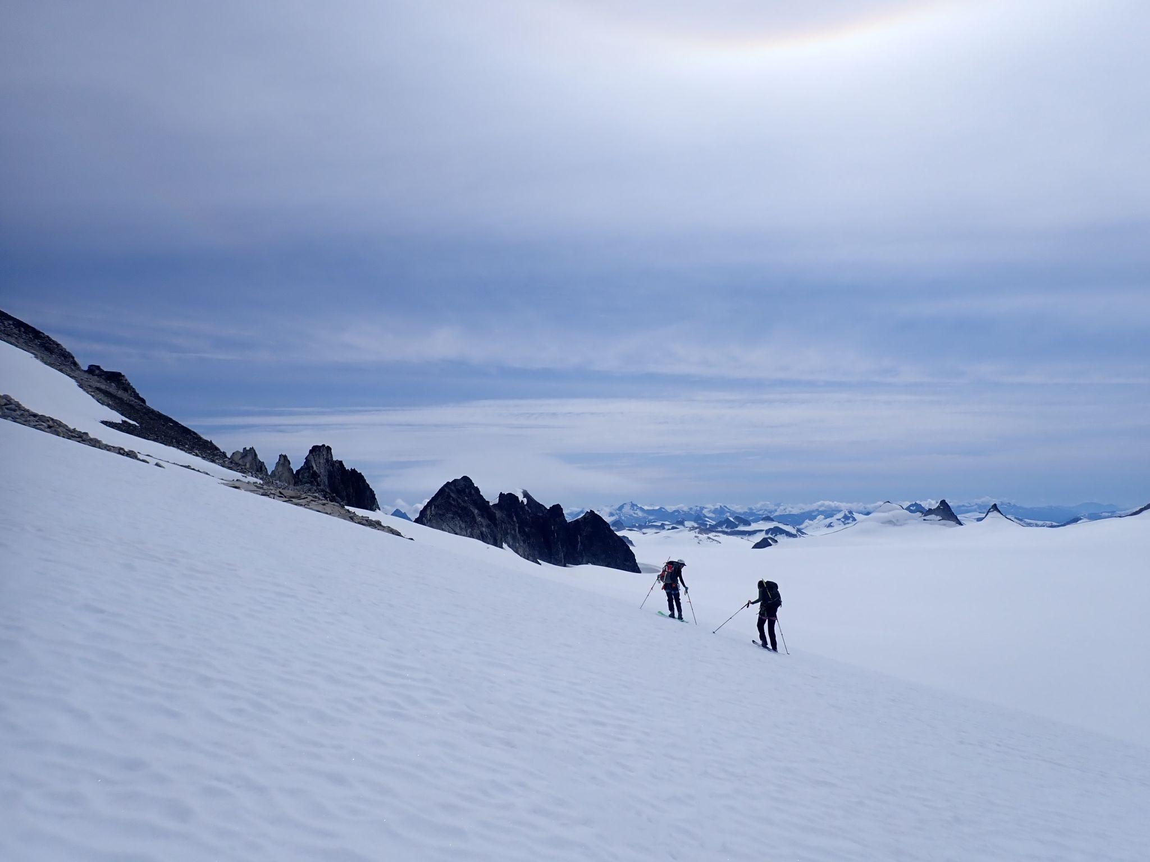
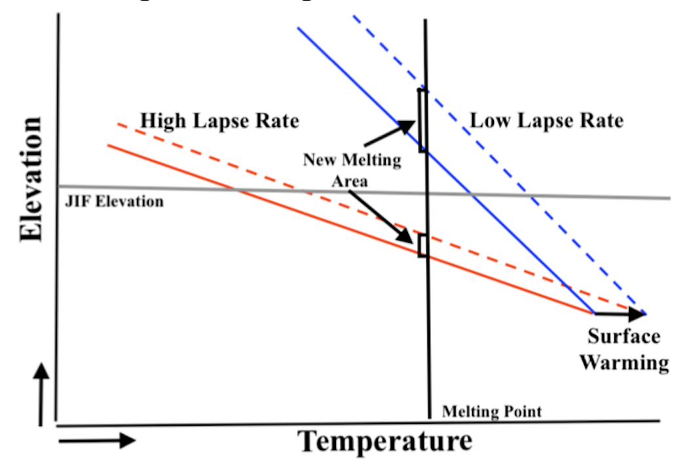
Multiple Scales of Lapse Rate Variability on the Juneau Icefield
Adelle Welch (Bates College), Julius Mex (Ecole Normale Supérieure Paris), Leah Fleming (University of New Hampshire), Lia Salomon (Carleton College), Sophia Ludtke (Harvard College), Daniel Otto (University of Washington), Mira Berdahl (University of Washington)
SUMMARY:
RESULTS:
METHODOLOGY:
• Near surface lapse rates, used to calculate high-elevation temperatures, are often assigned a generic value (e.g. 5℃/km) but are known to vary depending on a number of conditions • We use in situ air temperature measurements from the Juneau Icefield transects and data from Juneau Icefield Research Program (JIRP) weather stations to calculate lapse rates • Icefield lapse rates vary from 2.8℃/km to 8℃/km and exhibit a distinct diurnal cycle and seasonally variability
Data Sources:
A.) iButton temperature sensors (Fig. 2)
B.) Historical weather station data (1998-2018)
→ calculated a linear regression to determine lapse rate (℃/km)
Figure 4a
Figure 2b
Figure 3a
Figure 4. a) Juneau Icefield transect lapse rate measurements b) Diurnal cycle of lapse rates on the Juneau Icefield transects
Figure 2c
BACKGROUND:
• In regions without high-resolution temperature data, local data (ex. Juneau Airport data) can be extrapolated using a linear lapse rates • Yet, these linear lapse rates might neglect local factors such as slope, aspect, and surface properties
Figure 5. a) Seasonal dependency of daily lapse rates on the Juneau Icefield b) Seasonal dependency of diurnal lapse rates on the Juneau Icefield
• Variations include steeper lapse rates (Fig. 4 and Fig. 5) than used in previous Juneau Icefield mass balance studies (McNeil et al, 2020. O’Neel et al, 2019).
• Seasonal variations depend on slope, aspect, snow coverage, and local climate that is difficult to account for without high-resolution temperature data.
Figure 2d
Figure 2: a) A map of the Juneau Icefield showing b, c) the Taku A, Taku B, and Heather iButton temperature sensor transects deployed along the icefield July 2023 and d) the icefield plateau
Steeper lapse rate = greater vulnerability to glacial melt
ACKNOWLEDGEMENTS:
Special thanks to Mira Berdahl and Daniel Otto for their support, guidance and feedback throughout this project, to Bates and Carlton Colleges and Harvard University for funding this poster, to Jessica Badgeley for use of the iButton sensors, and to the Taku River Tlingit and Tagish people on whose unceded land this research was conducted.
Figure 1: Spatially and temporally specific lapse rates are important in projecting future ice field sensitivity ⇒ steeper lapse rate exposes greater glacial area to melt as global temperatures warm
•McNeil C, O’Neel S, Loso M, Pelto M, Sass L, Baker EH, Campbell S (2020). Explaining mass balance and retreat
dichotomies at Taku and Lemon Creek Glaciers, Alaska. Journal of Glaciology 66(258), 530–542. https://doi.org/10.1017/jog.2020.22
•O’Neel S, McNeil C, Sass LC, Florentine C, Baker EH, Peitzsch E, McGrath D, Fountain AG, Fagre D (2019). Reanalysis of the US Geological Survey Benchmark Glaciers: long-term insight into climate forcing of glacier mass balance. Journal of Glaciology 65, 850–866. https://doi.org/10.1017/jog.2019.66
Notes:
Updated graphs

Slide 3
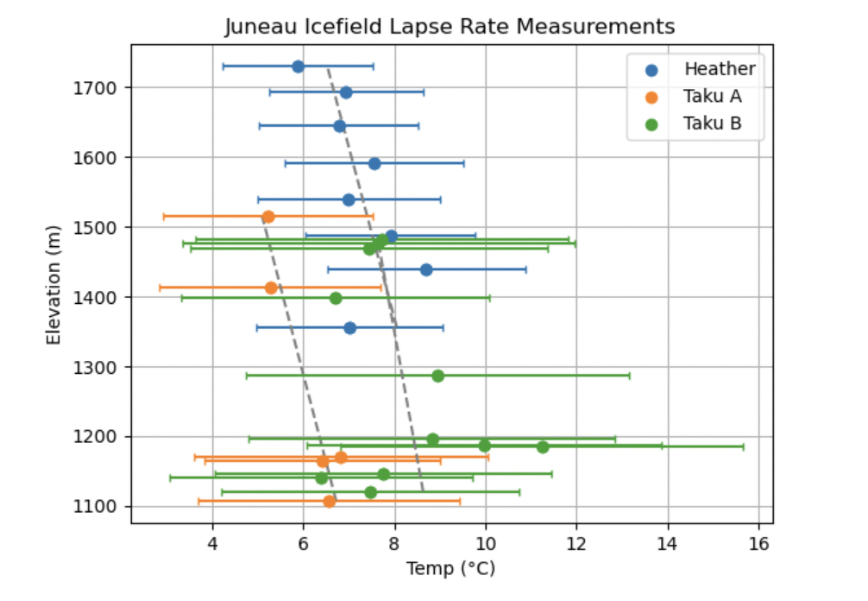
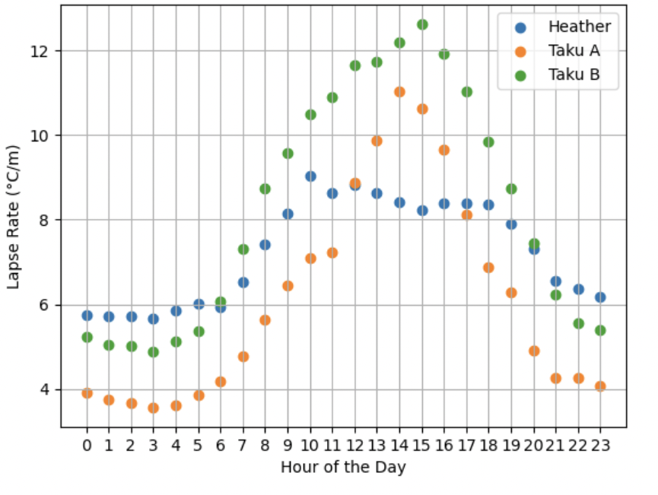
Spatial and Temporal Trends in Near Surface Lapse Rates on the Juneau Icefield
Adelle Welch (Bates College), Julius Mex (Ecole Normale Supérieure Paris), Leah Fleming (University of New Hampshire), Lia Salomon (Carleton College), Sophia Ludtke (Harvard College), Daniel Otto (University of Washington), Mira Berdahl (University of Washington)
SUMMARY:
METHODOLOGY:
CONCLUSIONS:
Data Sources:
A.) iButton temperature sensors deployed at three transects across the Juneau Icefield — referred to as Taku A, Taku B, and Heather (see Fig. 2) — over several days during July 2023 (Fig. 3)
• Lapse rates vary greatly (2.8℃/km to 8℃/km) through seasonal and diurnal cycles (Fig. 6).
• Variations include steeper lapse rates (Fig. 4 and Fig. 5) than used in previous Juneau Icefield mass balance studies (McNeil et al, 2020. O’Neel et al, 2019).
• Seasonal variations depend on slope, aspect, snow coverage, and local climate that is difficult to account for without high-resolution temperature data.
• Near surface lapse rates, used to calculate high-elevation temperatures, are often assigned a generic value (e.g. 5℃/km) but are known to vary depending on a number of conditions • We use in situ air temperature measurements from the Juneau Icefield transects and data from Juneau Icefield Research Program (JIRP) weather stations to calculate lapse rates • Icefield lapse rates vary from 2.8℃/km to 8℃/km and exhibit a distinct diurnal cycle and seasonally variability
Figure 3a
BACKGROUND:
Figure 3b
• In regions without high-resolution temperature data, local data (ex. Juneau Airport data) can be extrapolated using a linear lapse rates • Yet, these linear lapse rates might neglect local factors such as slope, aspect, and surface properties
Figure 4. a) Juneau Icefield transect lapse rate measurements b) Diurnal cycle of lapse rates on the Juneau Icefield transects
Steeper lapse rate = greater vulnerability to glacial melt
Figure 3c
Figure 2
B.) Historical measurements from Juneau Icefield weather station data (1998-2018)
Figure 5. a) Seasonal dependency of daily lapse rates on the Juneau Icefield b) Seasonal dependency of diurnal lapse rates on the Juneau Icefield
Figure 1: Spatially and temporally specific lapse rates are important in projecting future ice field sensitivity ⇒ steeper lapse rate exposes greater glacial area to melt as global temperatures warm
→ calculated a linear regression to determine lapse rate (℃/km)
ACKNOWLEDGEMENTS:
Special thanks to Mira Berdahl and Daniel Otto for their support, guidance and feedback throughout this project and to the Taku River Tlingit and Tagish people on whose unceded land this research was conducted.

